Slide 1

STROKE
in
Arkansas
Notes:
Introduce yourself, coworkers and what hospital you are representing!
This is also a great time to give a little background story of why you are there OR why you are a nurse / healthcare worker!

Slide 2
The Stroke Program

Slide 3
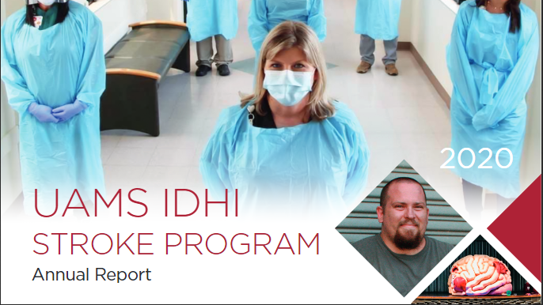
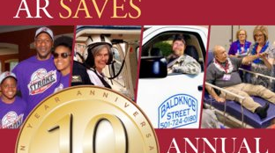
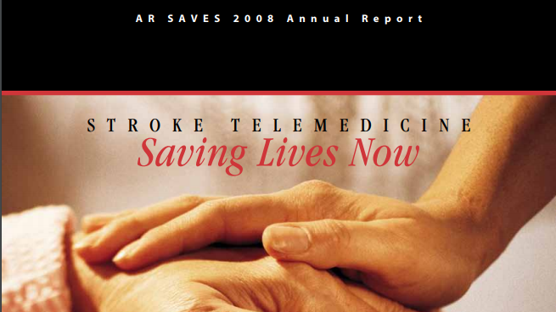
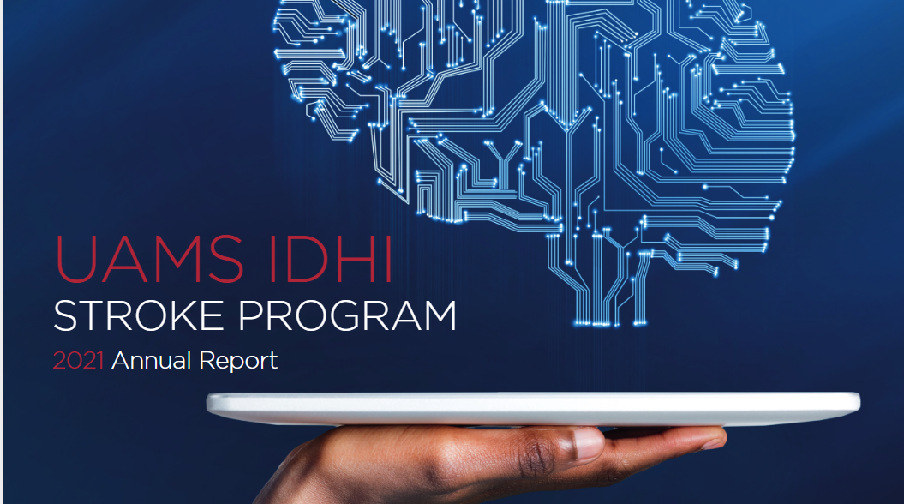

Slide 4
The Stroke Program continued
The program links emergency room doctors at participating hospitals to specially trained stroke specialists via live, two-way video, available 24-hours a day to ensure fast, life-saving treatment of stroke patients.
Ischemic strokes, the most common type of stroke, can be treated with a clot-buster that dissolves blood clots obstructing blood flow to the brain. People suffering from stroke symptoms must BE FAST getting to the hospital to receive treatment.

Slide 5
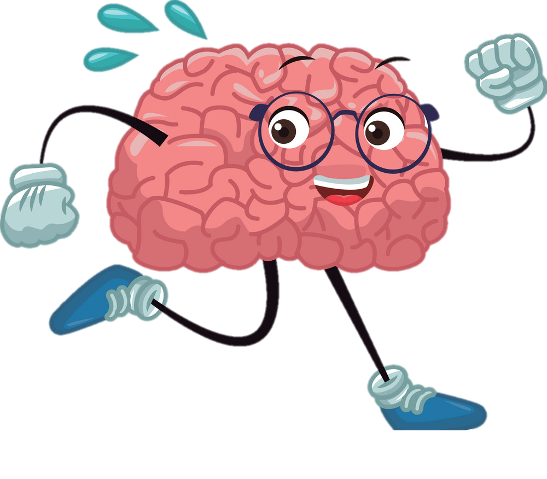
What is a stroke
A brain attack!
A stroke occurs when blood flow to the brain is blocked or a blood vessel bursts!
Notes:
Explain to your audience stroke is an attack on the brain. Explain brain cells die every second a stroke is attacking your brain.

Slide 6

What is a Stroke?
Click HERE to read
Notes:
Grandpa's Crooked Smile is an educational book that explains the importance of a child any age to know the signs and symptoms of a stroke. Children can save lives!
Links to book reading:
https://youtu.be/2KrnjdXisjU
https://console.virtualpaper.com/Clear_River/strokestorybook-activity/

Slide 7
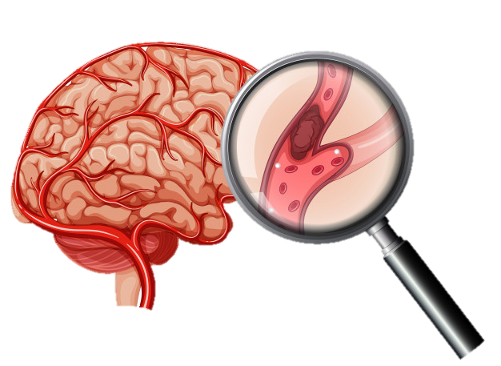
Two Main Types of Stroke etc.
Ischemic (Blockage) Stroke
Blocked blood vessel
87% of all cases
Notes:
Ischemic: 87% of all cases. Occurs due to an obstruction within the blood vessel.

Slide 8
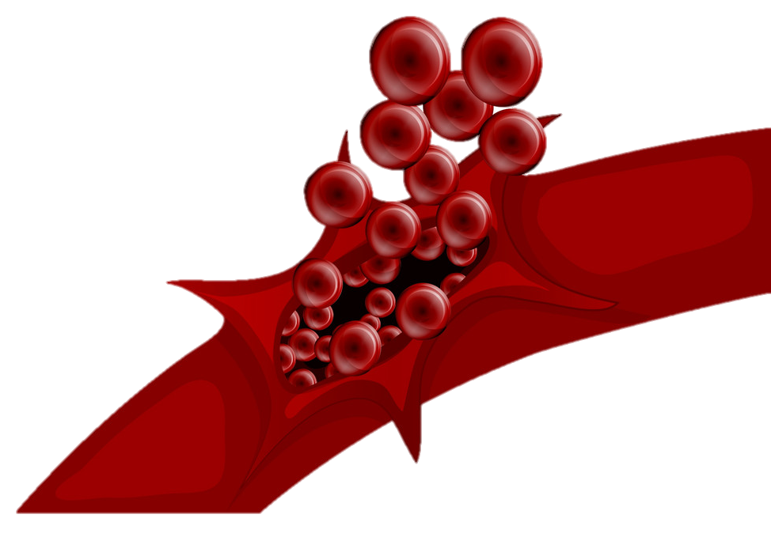
Two Main Types of Stroke
Hemorrhagic (Bleeding) Stroke
Blood vessel bursts
13% of cases
Notes:
Hemorrhagic: 13% of stroke cases. Weakened blood vessel that ruptures and bleeds causing blood to press down on the brain tissue.

Slide 9

The Three Hour Window
4.5 Hours
Notes:
A person experiencing a stroke has a three hour window to get to the hospital and begin treatment.
In some cases, the window is extended up to 4.5 hours but the sooner treatment begins is always better!

Slide 10
Community Outreach

Slide 11
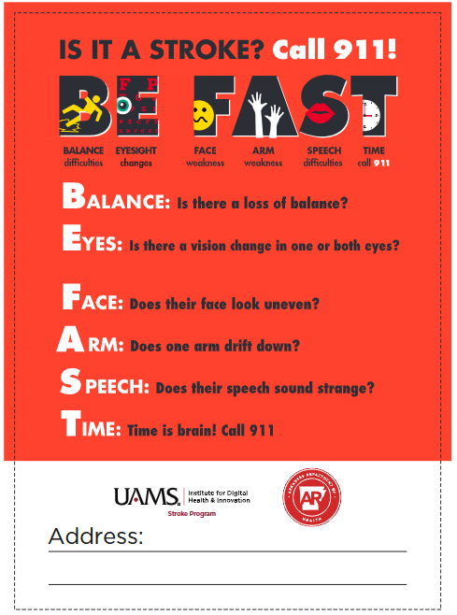
Recognition of stroke signs and symptoms using BE FAST
Stroke is an EMERGENCY
Call 9-1-1
Know your nearest stroke-ready hospital

Slide 12
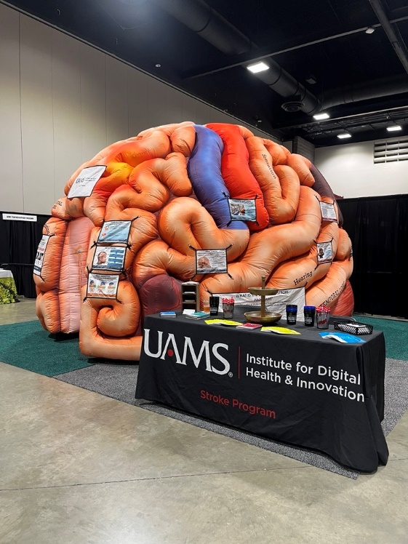
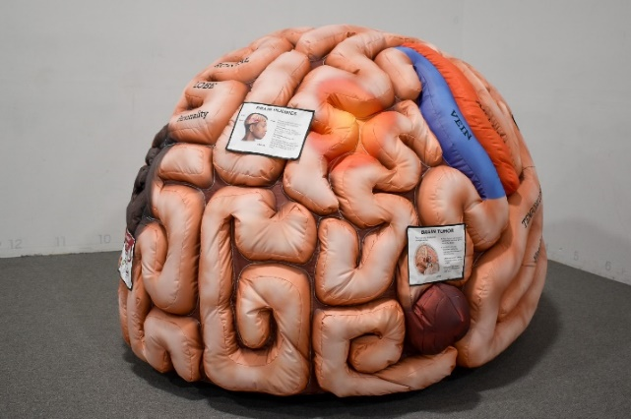
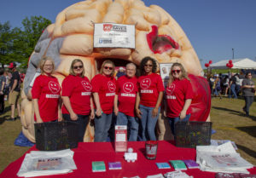
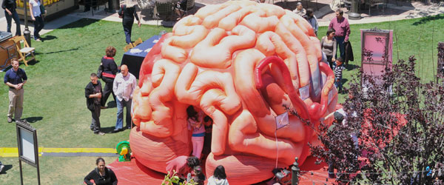
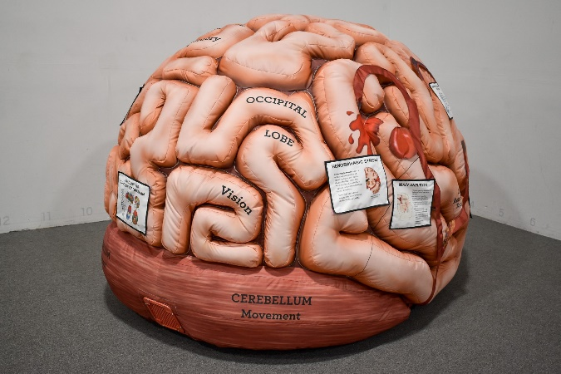
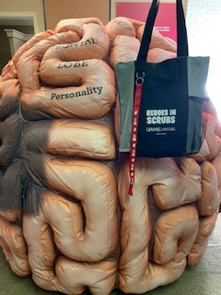
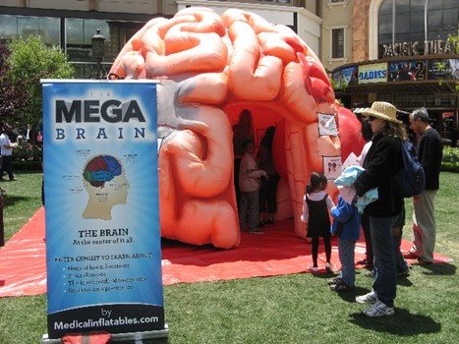
Stroke Program Mega and Mini Brains!
Notes:
The Mega Brain and Minis are portable, inflatable walk-through brain exhibits that are teaching tools to educate about stroke signs and symptoms.
The Mega Brain and Minis provide a guided tour of the brain and an opportunity to ask questions about stroke signs and symptoms.

Slide 13
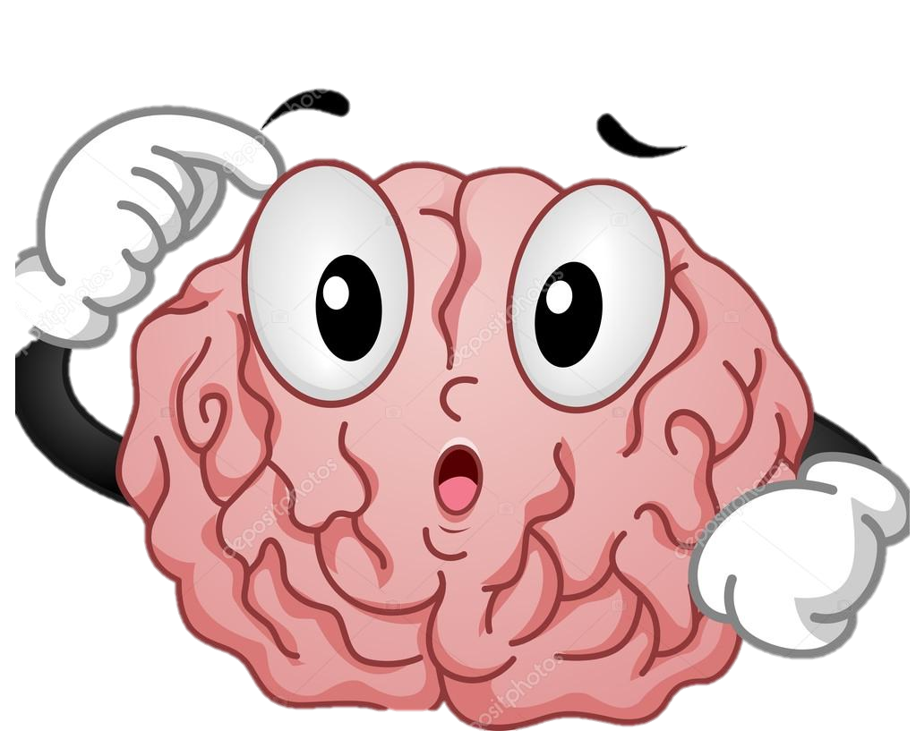
What are risk factors you can’t control?
Gender
Family History
Race / Ethnicity
Prior Stroke/ TIA
Age
Notes:
After age 55 the risk of having a stroke doubles every 10 years.
If any of your immediate family members have a stroke, especially before age 65, you could be at a greater risk.
Those of the African American race have a much higher risk of death from strokes than Caucasians do because they have more stroke risk factors: hypertension, diabetes, obesity, and smoking.
Women are at a higher risk of strokes than men. Strokes kill more than twice as many women as breast cancer. This can be do to changes after menopause which includes increases in blood pressure, cholesterol, and diabetes.
Those who have had a previous stroke are at a greater risk of having another. Those who have had one or more TIAs are almost 10x more likely to have a stroke.

Slide 14
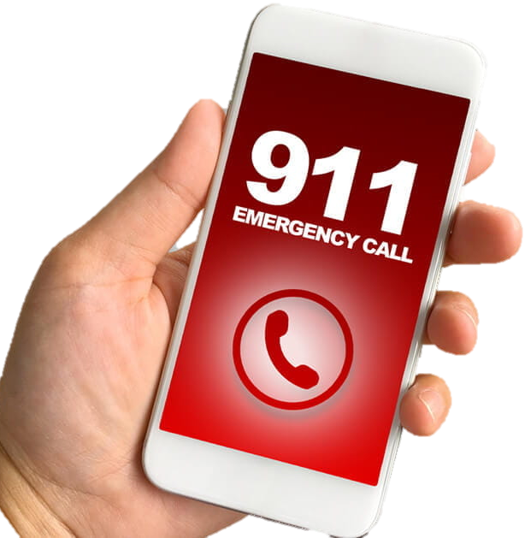
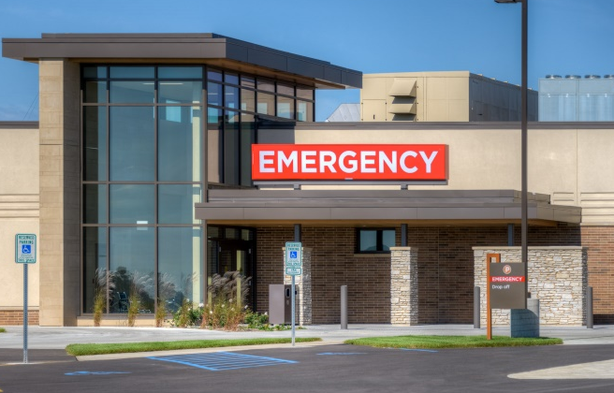
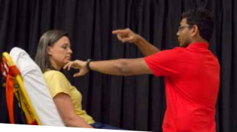
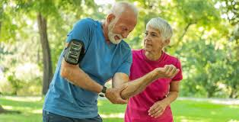
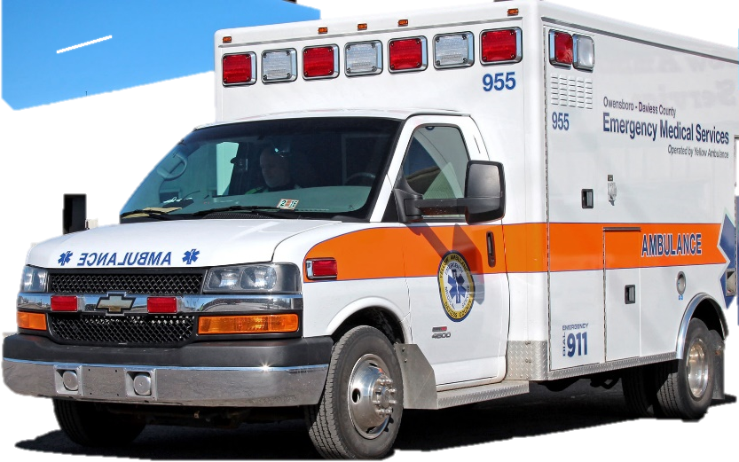
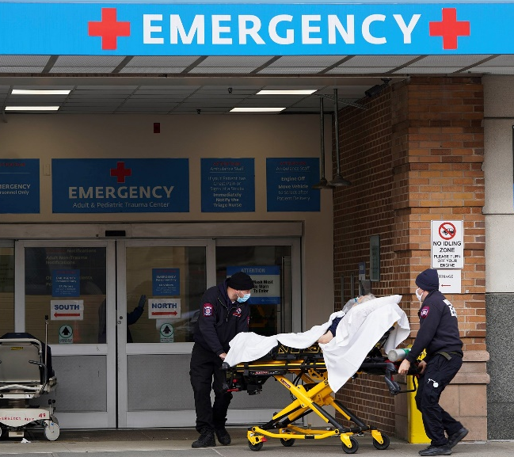
What we do, why we do it, and how we help YOU!
Notes:
We help those who live in rural Arkansas use the hospital closest to them. Everyone deserves the same level of care regardless of where they live.

Slide 15
Questions
Thank You!
Notes:
Motivate your audience to ask questions. Remember no question is a bad question about stroke!

Slide 16
REFERENCES
Source: Cdc.gov. 2025. Stroke Signs And Symptoms | CDC.Gov. https://www.cdc.gov/stroke/signs_symptoms.htm
Source: Interactive atlas of heart disease and stroke. (n.d.). https://nccd.cdc.gov/DHDSPAtlas/Default.aspx?state=AR
Source: American Stroke Association. Preventing Stroke Presentation | American Stroke Association

