Slide 1
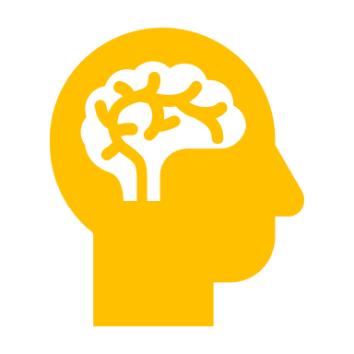

STROKE
in
Arkansas
Notes:
Introduce yourself, coworkers and what hospital you are representing!
This is also a great time to give a little background story of why you are there OR why you are a nurse / healthcare worker!

Slide 2
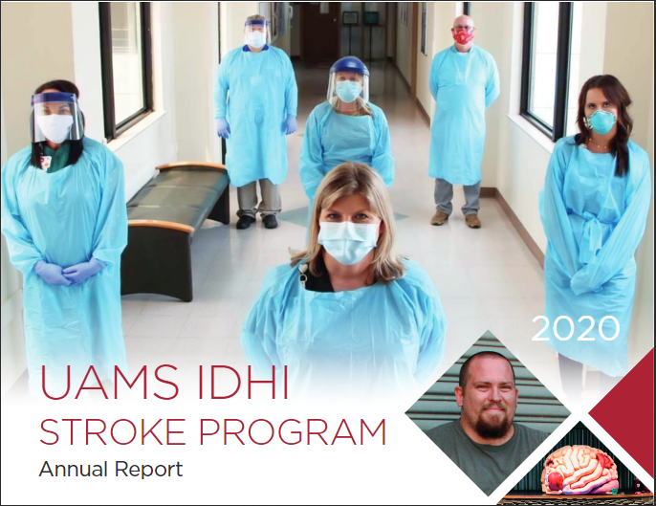
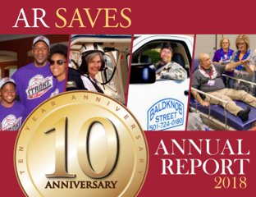
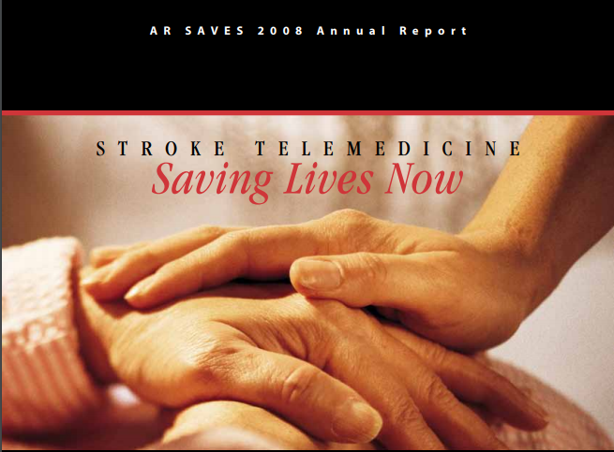
The Stroke Program
Statewide System of Care – Rural Arkansas
Designed for Everyone
“Where you live should not determine if you live or die” - Bono
AR Ranked #1 Nationally for Stroke Deaths

Slide 3
The Stroke Program continued
The program links emergency room doctors at participating hospitals to specially trained stroke specialists via live, two-way video, available 24-hours a day to ensure fast, life-saving treatment of stroke patients.
Ischemic strokes, the most common type of stroke, can be treated with a clot-buster that dissolves blood clots obstructing blood flow to the brain. People suffering from stroke symptoms must BE FAST getting to the hospital to receive treatment.

Slide 4
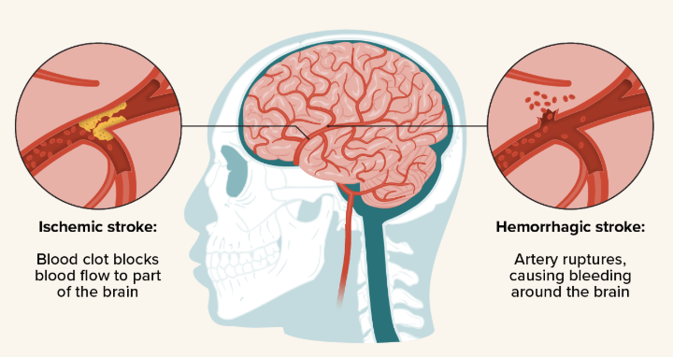
What is a stroke?
It’s a brain attack!
A stroke occurs when blood flow to the brain is blocked or a blood vessel bursts!
Sudden death of brain cells in an area of the brain
Why? Lack of blood flow to the brain
Two main types of strokes:
Ischemic stroke:
87% of all cases
Blocked blood vessel
Hemorrhagic stroke:
13% of cases
Blood vessel bursts
Notes:
Explain to your audience stroke is an attack on the brain. Explain brain cells die every second a stroke is attacking your brain.

Slide 5
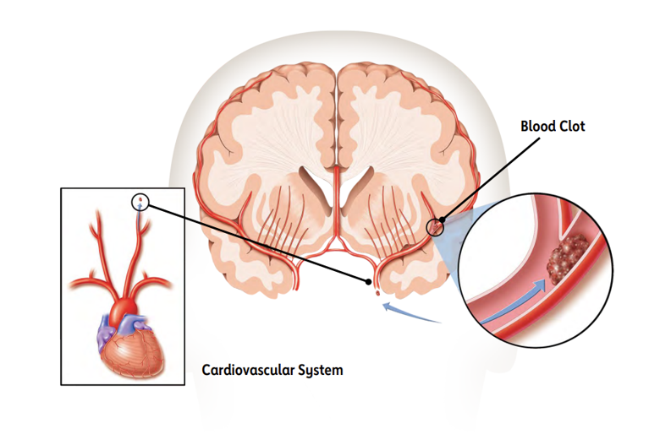
Ischemic Stroke
Ischemic stroke is the most common type of stroke, accounting for about 87% of strokes.
An ischemic stroke occurs when a clot blocks a vessel supplying blood to the brain. The artery becomes narrowed or clogged, cutting off blood flow to brain cells.

Slide 6
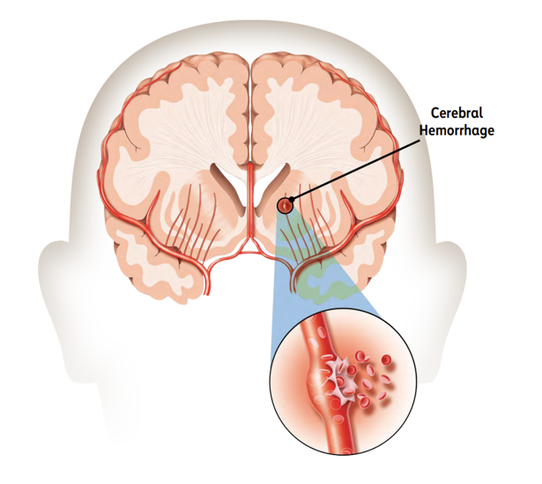
Hemorrhagic Stroke
A hemorrhagic stroke happens when a blood vessel bursts (ruptures) in the brain.
This type of stroke may affect large arteries in the brain or the small blood vessels deep within the brain. The rupture keeps the surrounding areas of the brain from getting oxygen.
Hemorrhagic strokes are less common than ischemic strokes, accounting for about 13% of strokes. However, they are associated with a higher risk of death.

Slide 7
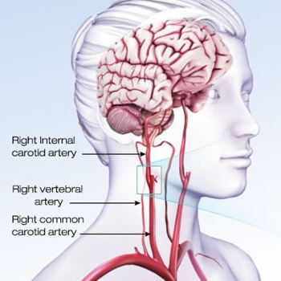
What is a TIA and what can I do about it?
A transient ischemic attack, or TIA, is a temporary blockage of blood flow to the brain. The clot usually dissolves on its own or gets dislodged, and the symptoms usually last less than five minutes.
TIA: Transient Ischemic Attack
Mini Stroke = WARNING
Can be a sign of a full stroke.
Does NOT cause lasting damage.
Symptoms can mimic a real stroke.
Who is at risk?
Notes:
TIA: WARNING STROKE. Can be a precursor to a full stroke. Do NOT cause lasting damage, but a full stroke can. Can mimic a stroke with less severe symptoms.
Why doesn’t it cause lasting damage- the body resolves the blockage and blood flow is restored quickly
Who is at risk- anyone- regardless of age. Those at a higher rate of susceptibility- stroke survivors

Slide 8
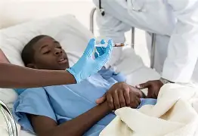
Treatment Options:
Ischemic (CLOT)
TNK: Tenecteplase
FDA approved.
It has a time limit…
any guesses?
  4.5 hours
How is it given?
IR-Interventional Radiology
Notes:
TPA is the only FDA approved treatment for ischemic strokes.
TPA is given though and IV, first in a bolus (stronger dose) then the remainder through an IV drip.
Another technique is physical removal of a clot with a mechanical tool- wired cage. It is treaded in with a catheter and a special suction tool removes it.
Hemorrhagic- A small tube (catheter) can be threaded up through a major artery in an arm or leg and guided into the brain tissue. A surgeon can use a camera to stop the bleeding with a mechanical agent such as a coil.

Slide 9

Time is brain
4.5Hours
Once a Stroke begins you lose brains cells.
It is important to BE FAST if you think you are experiencing a Stroke. Getting to the hospital fast so treatment can begin.
There is a 4.5 hour window to receive treatment once stroke symptoms begin.

Slide 10
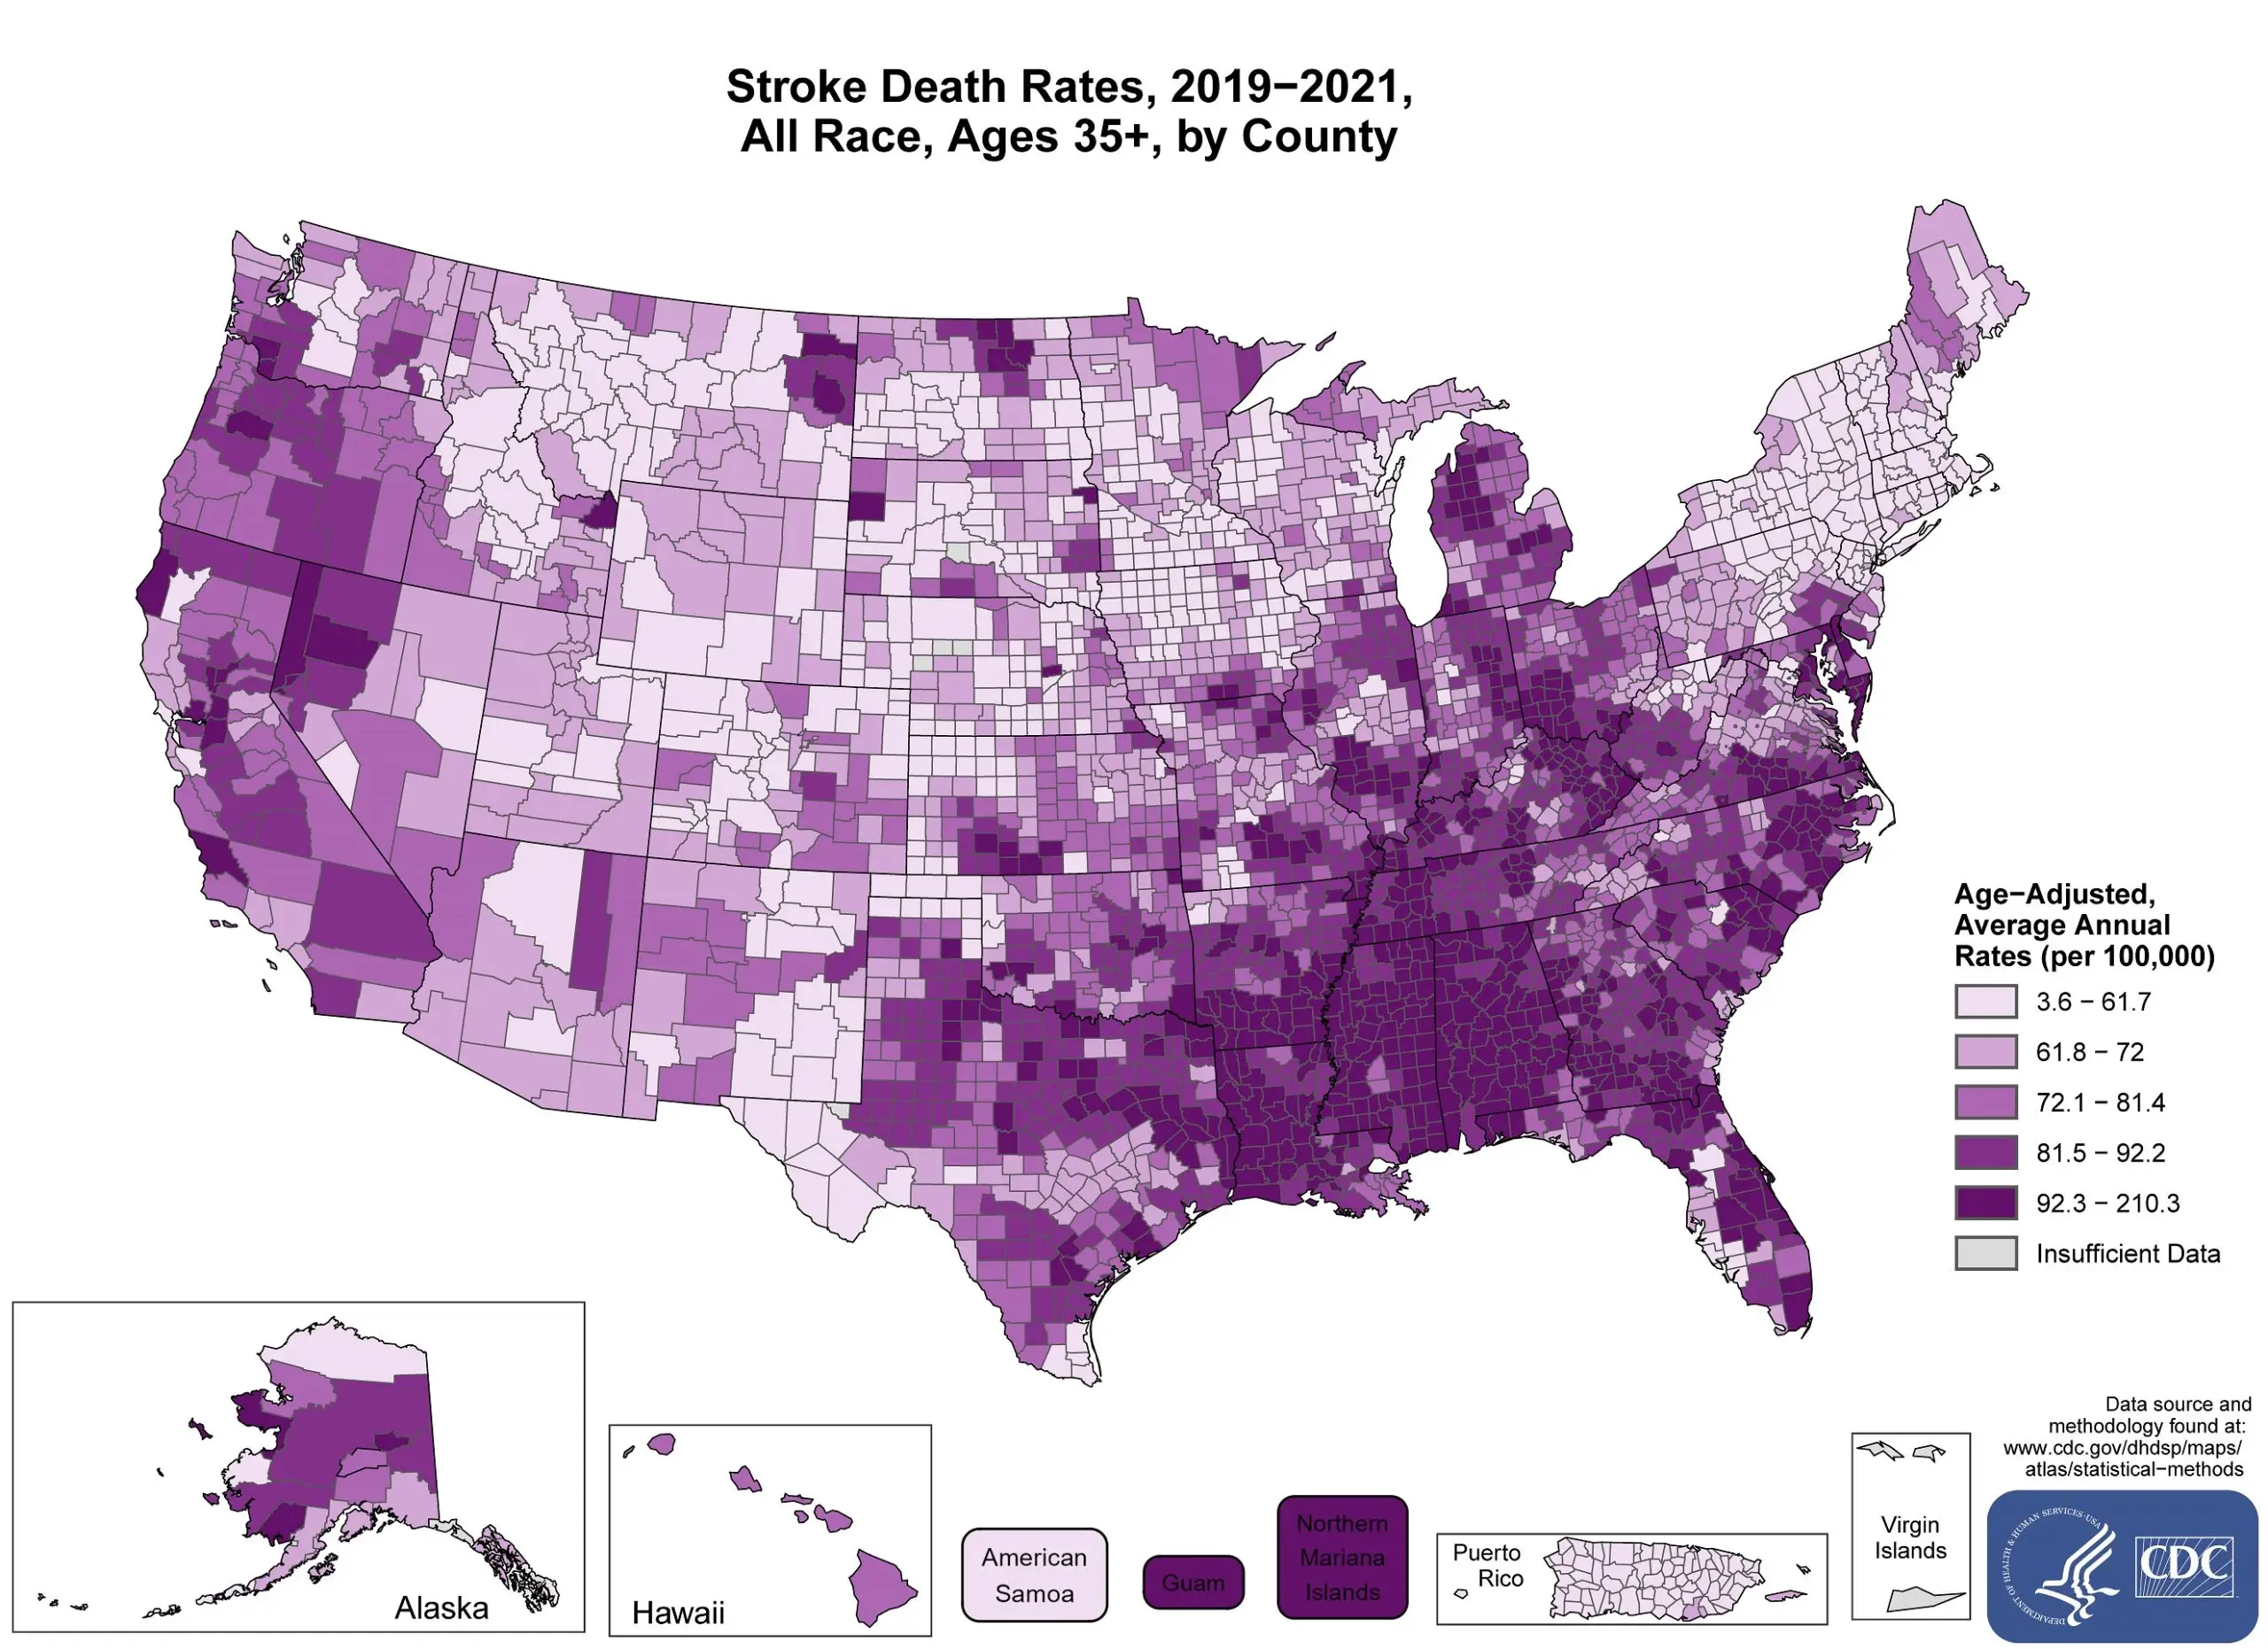
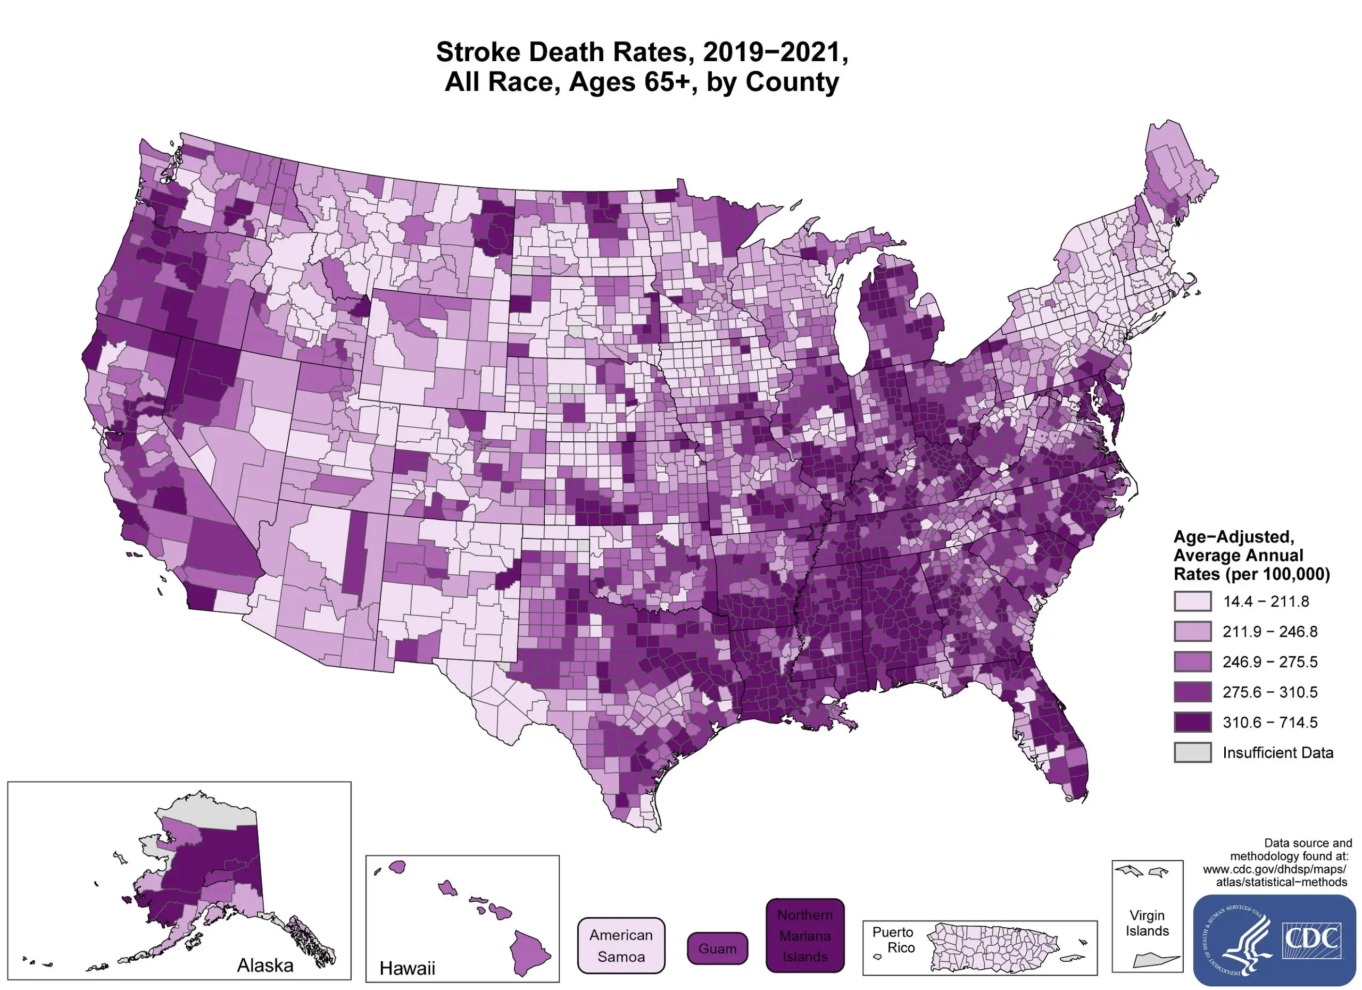
Notes:
Stroke Belt: Arkansas, Louisiana, Mississippi, Georgia, Alabama, North Carolina, South Carolina, Kentucky, Tennessee.
Stroke death rates, total population 35 and older. (2019, August 19). Retrieved February 02, 2021, from https://www.cdc.gov/dhdsp/maps/national_maps/stroke_all.htm

Slide 11
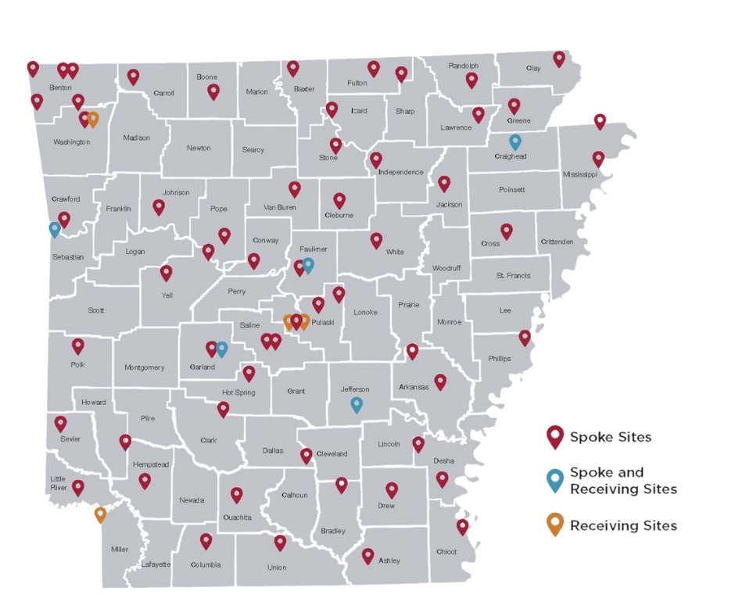
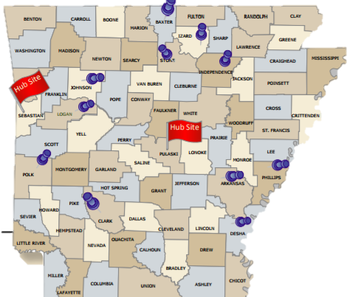
2008
2025
Notes:
Every person in Arkansas is within a hour of a AR SAVES hospital

Slide 12
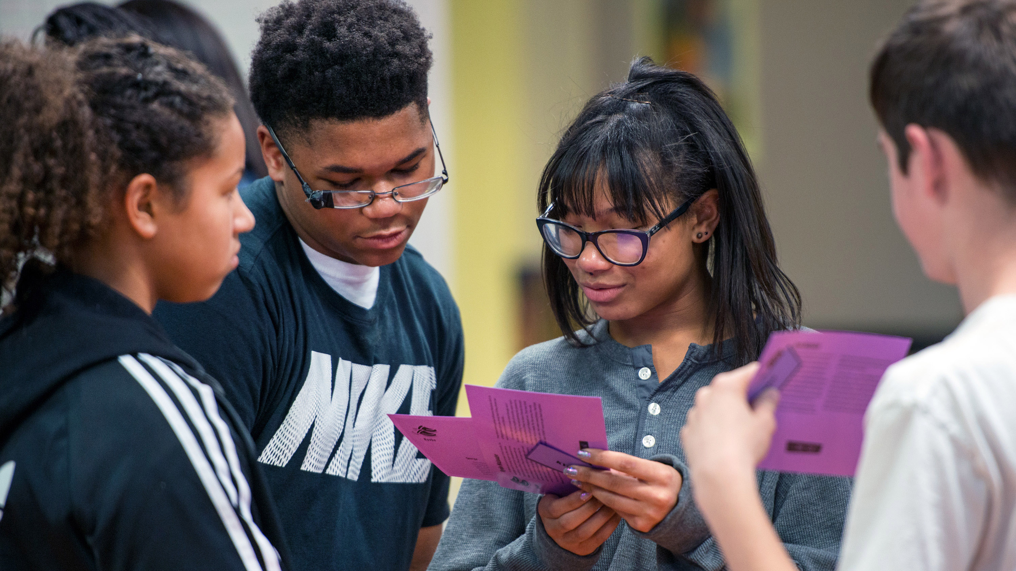
Community Outreach
This Photo by Unknown Author is licensed under CC BY

Slide 13
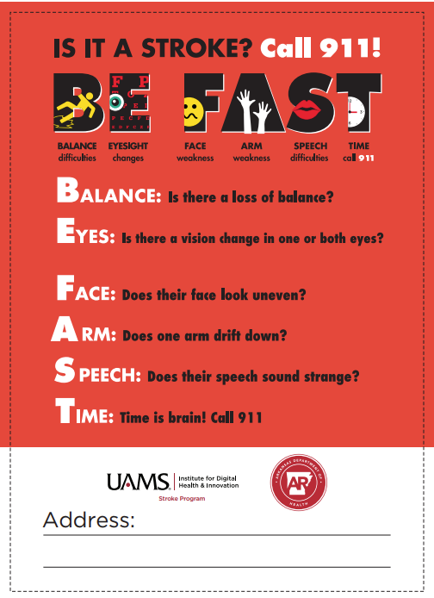
SIGNS AND SYMPTOMS

Slide 14
How the Stroke program helps the community!
Stroke Program sites are required to complete a minimum of 2 outreach events a month.
63 sites= 126 events a month.
2,643 community events in 2024
680,654 community members reached in 2024

Slide 15
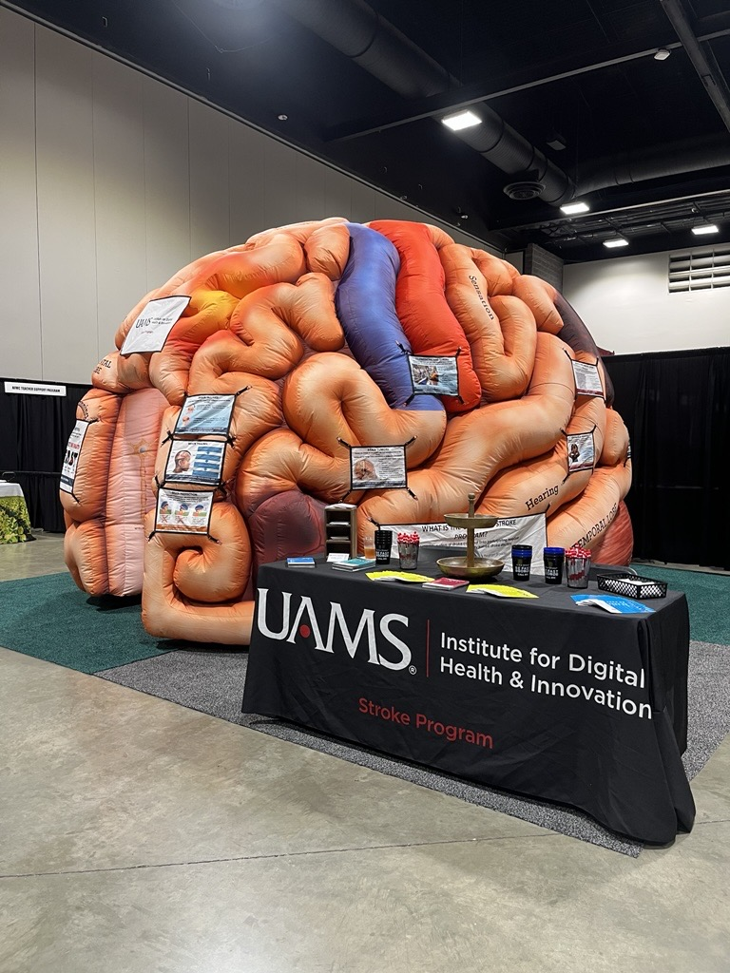
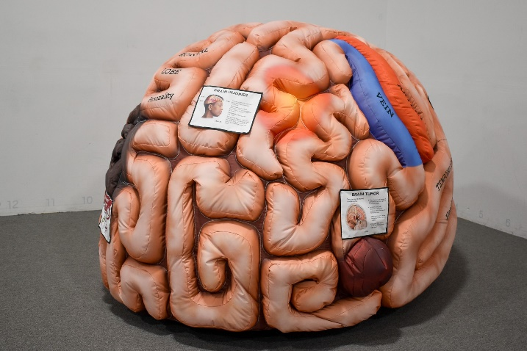
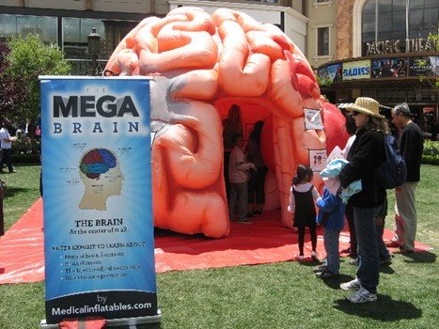
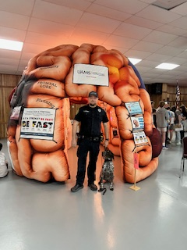
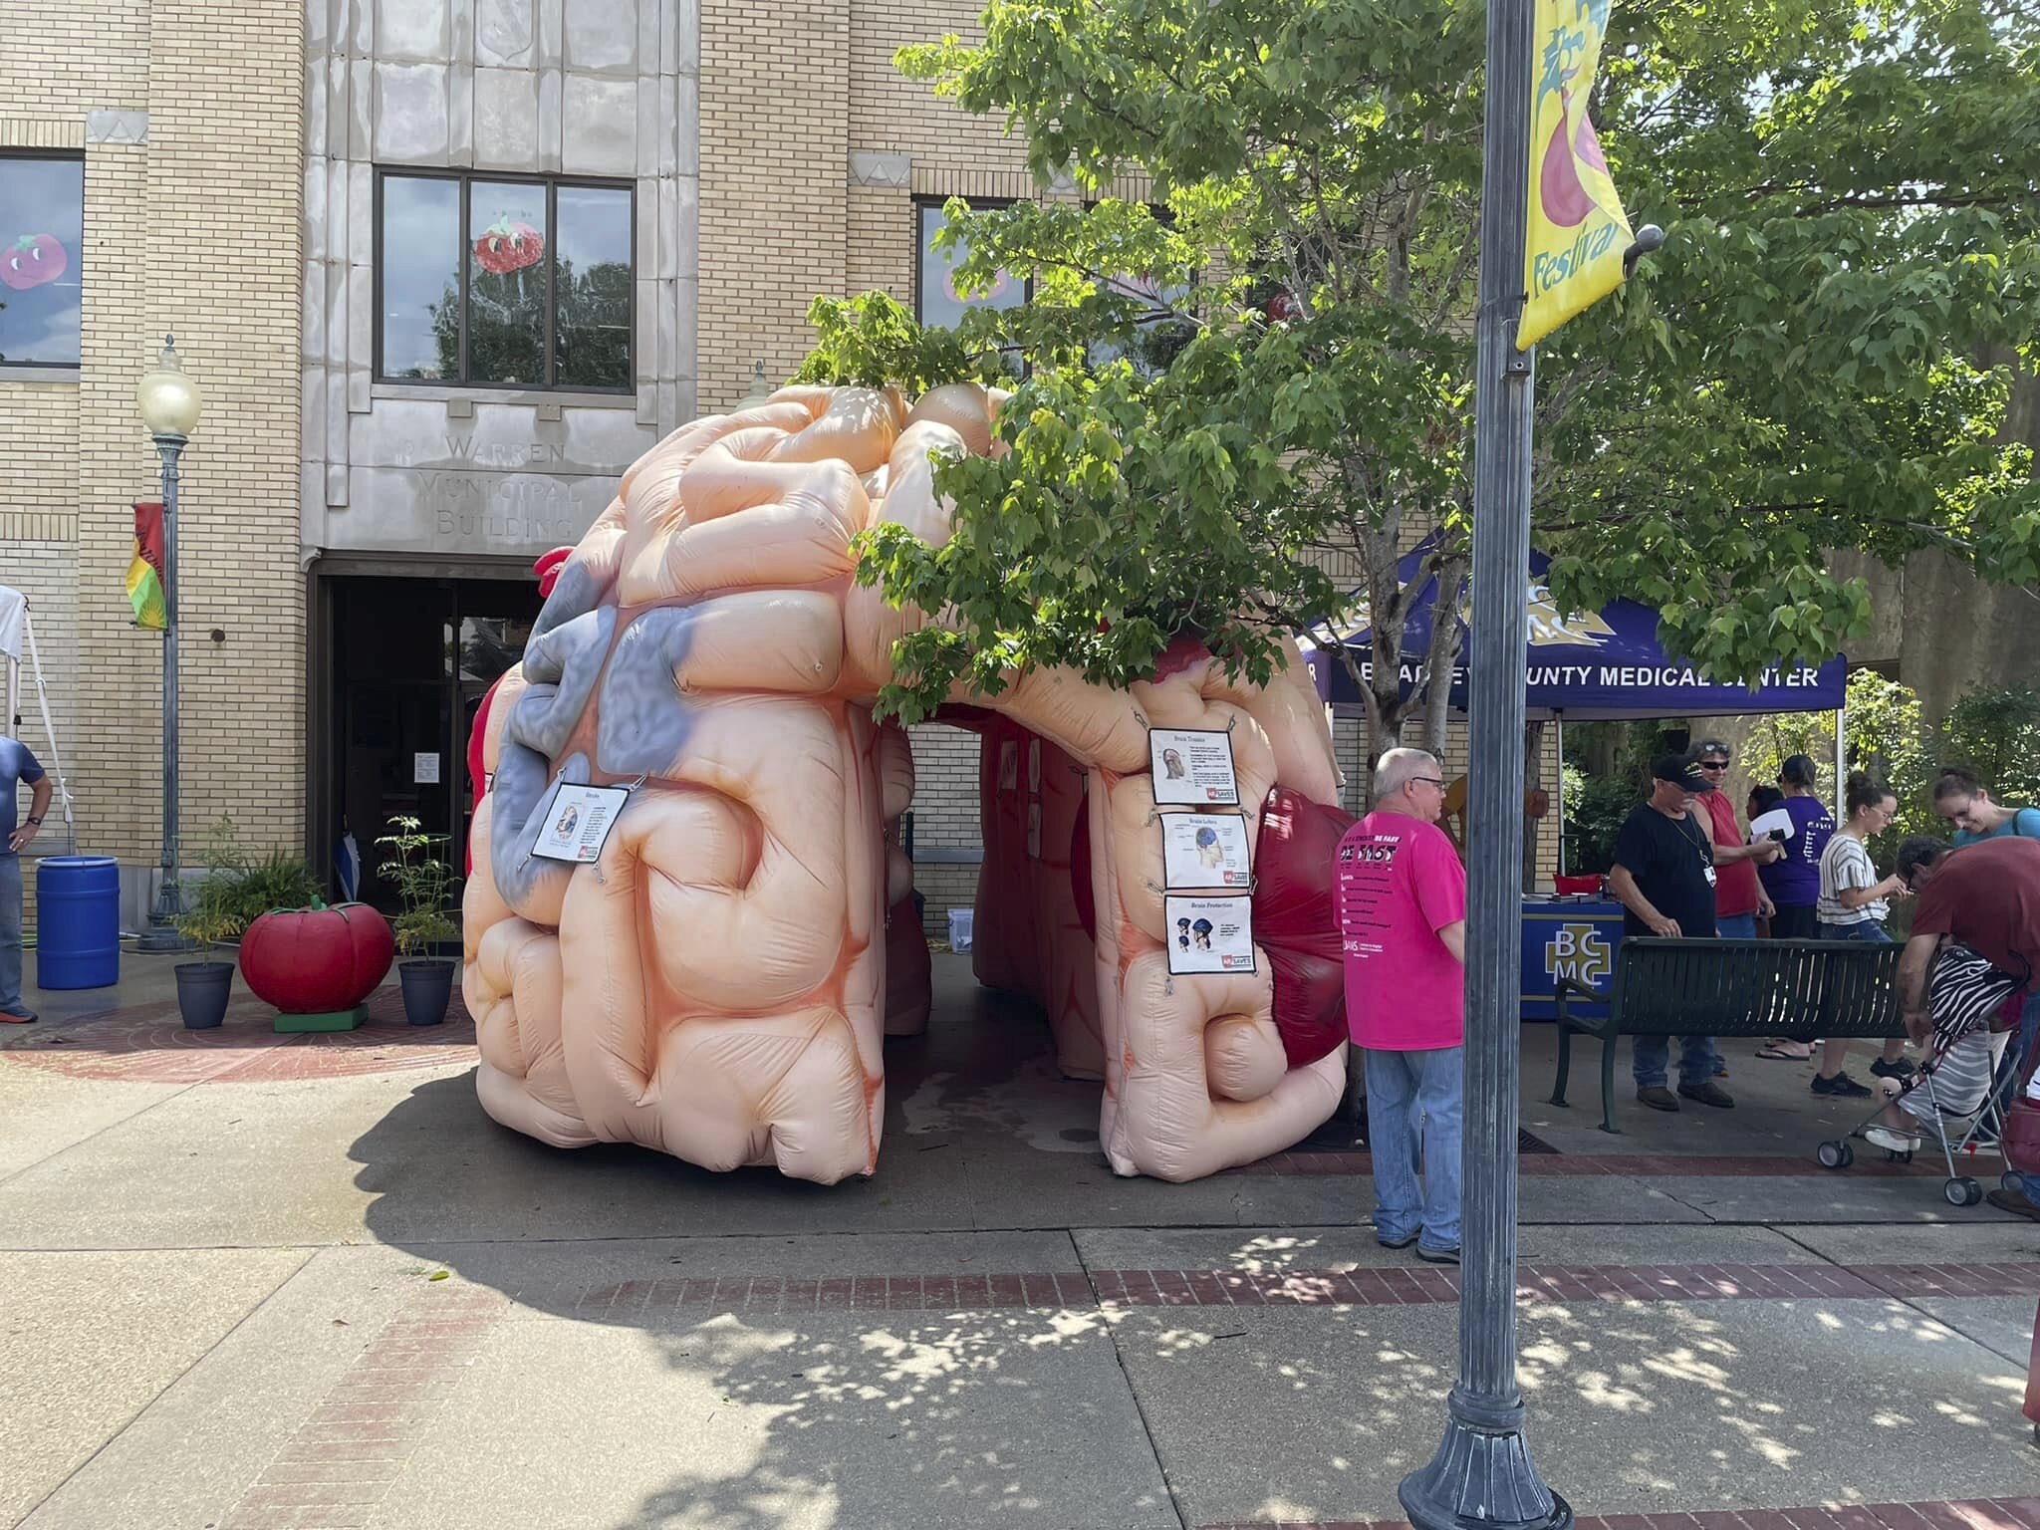
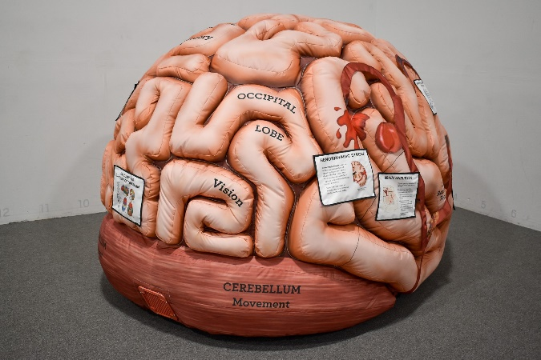
Stroke Program Mega and Mini Brains!

Slide 16
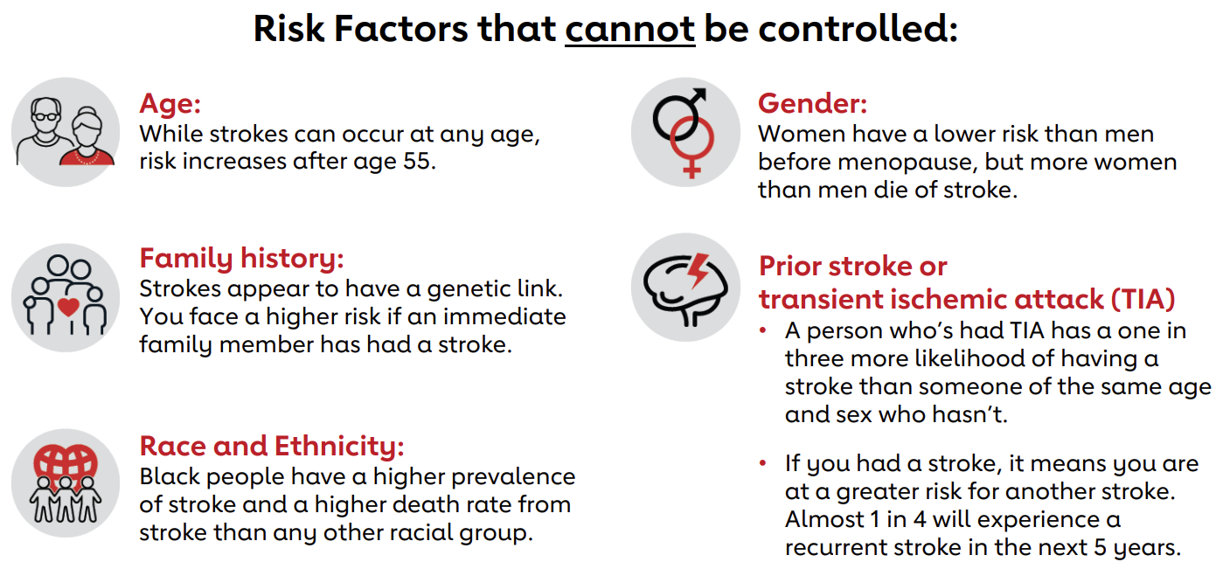

Slide 17
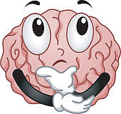

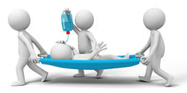
What NOT to do if you’re having a STROKE!
Know the symptoms! Most people don’t recognize the BE FAST stroke symptoms.
Deny it- TIME IS BRAIN!
Think nothing can be done- tPA
Worry about the cost.
Think symptoms will go away.
Fear or have a distrust in your hospital.
Notes:
The cost will be more significant if you are put in a long term care facility or a family member has to sacrifice to take care of you, acute care!
32,000 brain cells die every second you’re having a stroke.
Our program allows UAMS neurologist in 54 hospitals in the state!

Slide 18
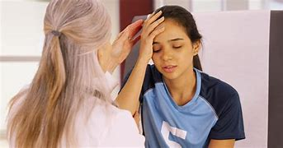
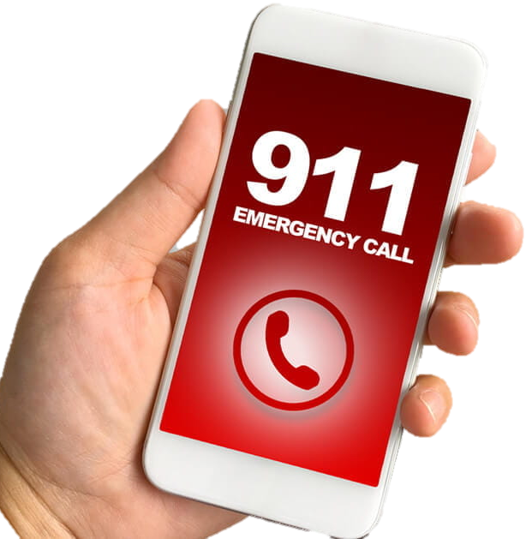
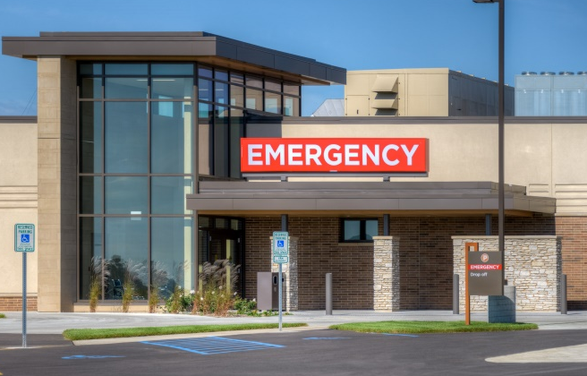
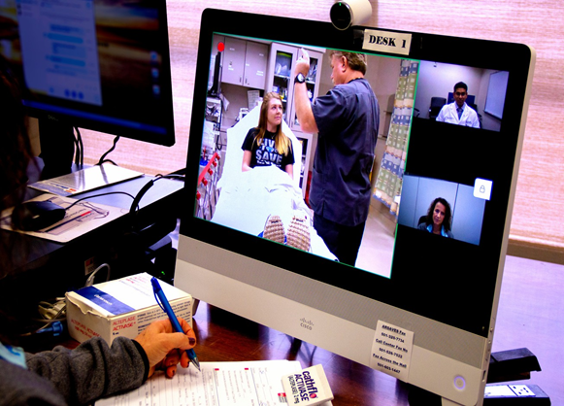
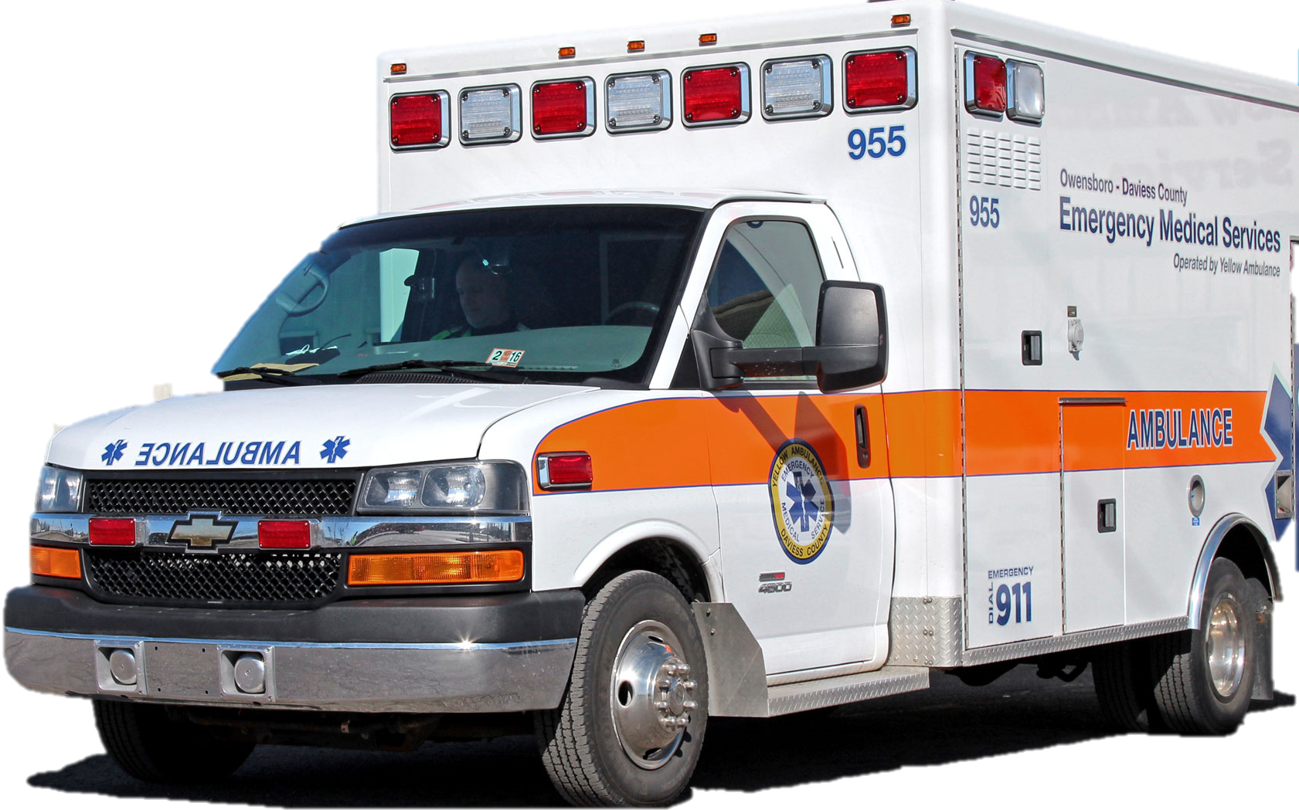
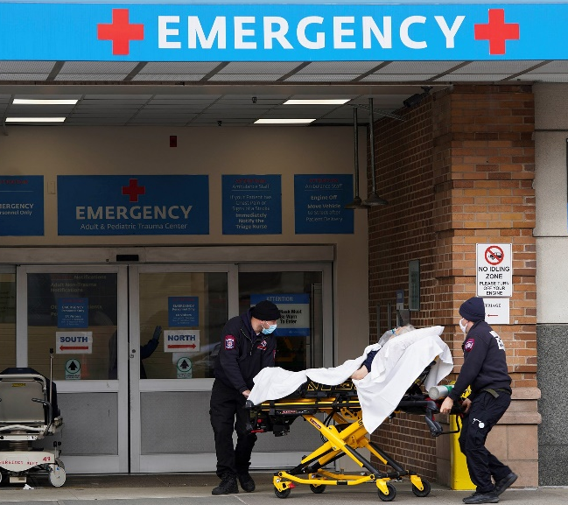
What we do, why we do it, and how we help YOU!
Notes:
We help those who live in rural Arkansas use the hospital closest to them. Everyone deserves the same level of care regardless of where they live.

Slide 19
Summary
Stroke is a “Brain Attack.”
Telemedicine is changing stroke care in Arkansas!
3 R’s for stroke: Reduce risks, Recognize symptoms, Respond—Call 911!
Together WE can Make a Difference!

Slide 20
Your turn to interview me
What questions would you like to ask me?

Slide 21
REFERENCES
Source: Cdc.gov. 2025. Stroke Signs And Symptoms | Cdc.Gov. https://www.cdc.gov/stroke/signs_symptoms.htm
Source: Interactive atlas of heart disease and stroke. (n.d.). https://nccd.cdc.gov/DHDSPAtlas/Default.aspx?state=AR
Source: American Stroke Association. Preventing Stroke Presentation | American Stroke Association

